Slide 1
Rotary
Builds Peace
Rotary believes that if concerned citizens work together to create peace locally, we can create lasting change globally.

Slide 3
My Background
Bachelor Degree International Relations .
6 years experience in humanitarian sector in Kenya & Somalia
Msc Peace and Conflict Studies, Uppsala University
Sponsored by district 9212 (Kenya, Ethiopia, Eritrea and South Sudan.)
My bio in Swedish is on the District 2360 webiste https://rotary2360.se/sv/content/news/show/6768?ce=1

Slide 4
The Rotary Peace Fellowship is:
Masters Degree in Peace in one of the 7 universities across the world (15-24months) or
A professional certificate program in one of two universities ; Chulalongkorn University , Thailand and Makerere University in Uganda (1 year)
Applications open until 15th May 2023, Rotary District endorsements by 1st July .

Slide 5
Makerere University in Africa is the 7th university

Slide 6
ROTARY PEACE CENTERS
20
Years
1600+
alumni
140 countries
Notes:
Since the Rotary Peace Centers began in 2002, over 1,600 people have graduated from the Fellowship program and are working on peace and development initiatives in more than 140 countries.

Slide 7
Eligibility ?
Have a strong commitment to cross-cultural understanding and peace as shown through professional and academic achievements and personal or community service
Potential for leadership
Share Rotary International’s Values - ‘Service above self’
Work experience ;at least 4 years
Notes:
Have at least three years of full-time experience in peace or development work
Have a bachelor's degree
You are not eligible if you are an active Rotary member, employee of a Rotary club, Rotary International, or other Rotary entity. – impartiality

Slide 8
The Uppsala Peace Fellow experience
Year 1
Year 2
Late August/early September - June
June – August
Late August/early September - January
January - June
Courses at Uppsala University
Applied Field Experience abroad/Sweden
Study in Uppsala or intern abroad
Writing the Master’s Thesis

Slide 9
Applied Field Experiences 2022 Class xx

Slide 10
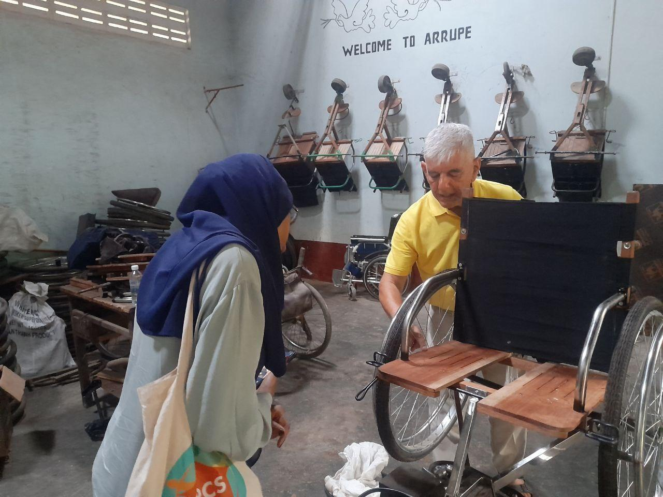
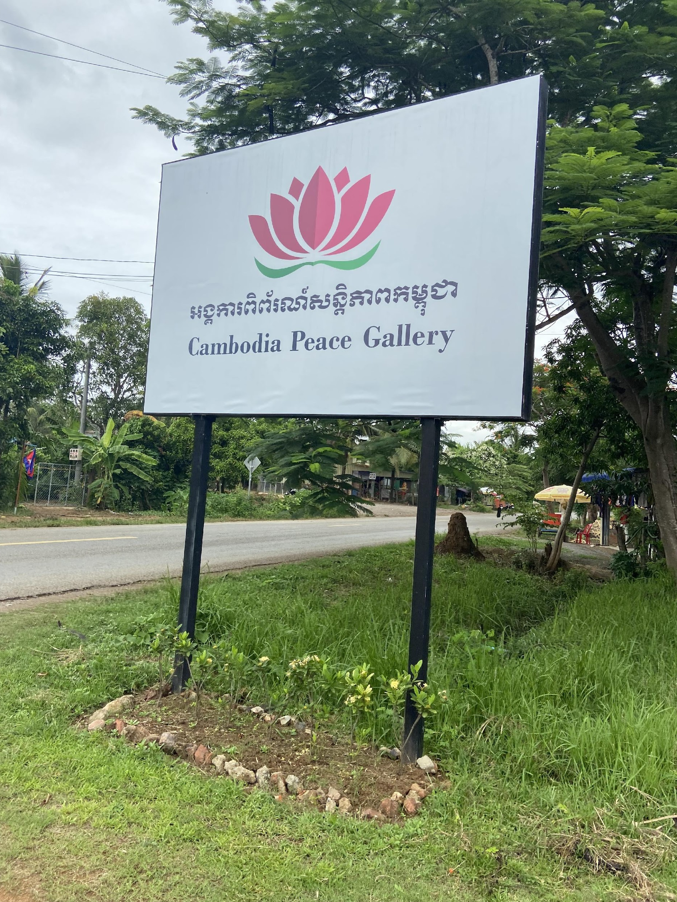

Slide 11
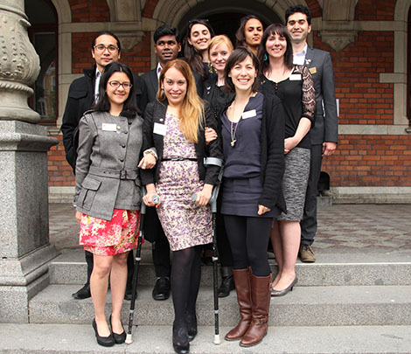
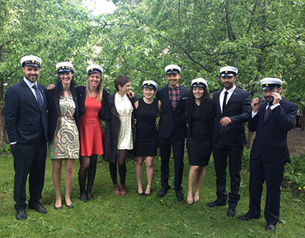
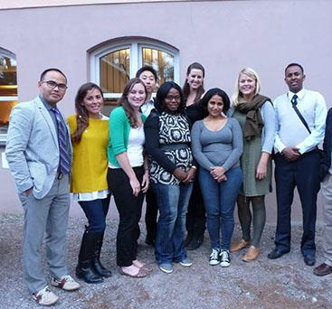
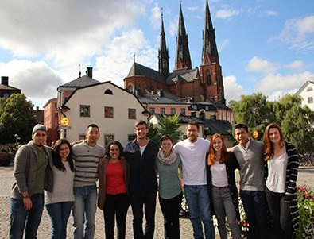
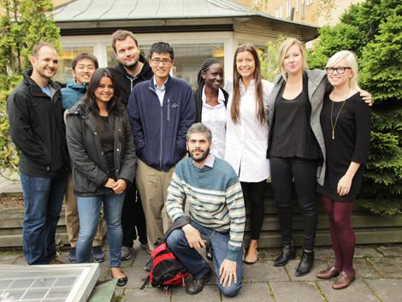
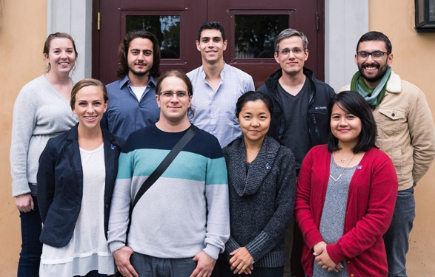
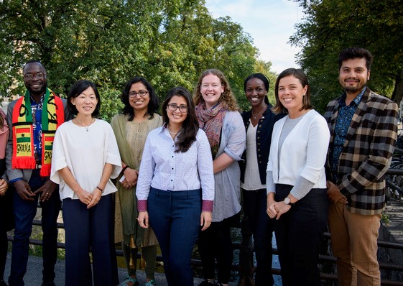
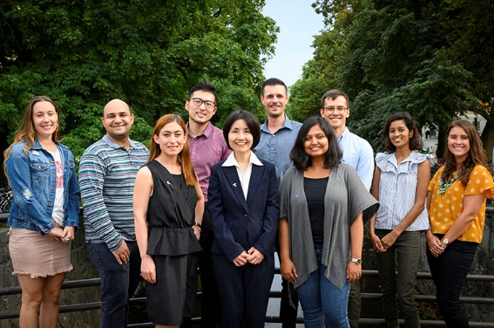
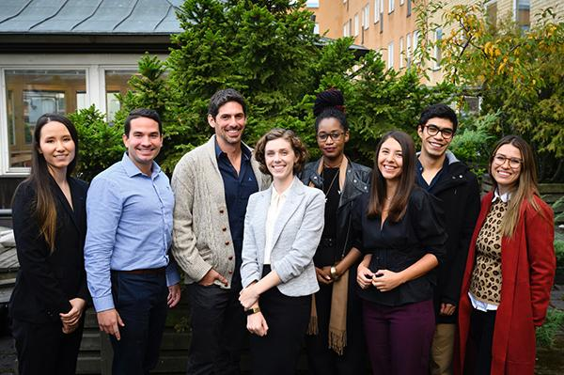
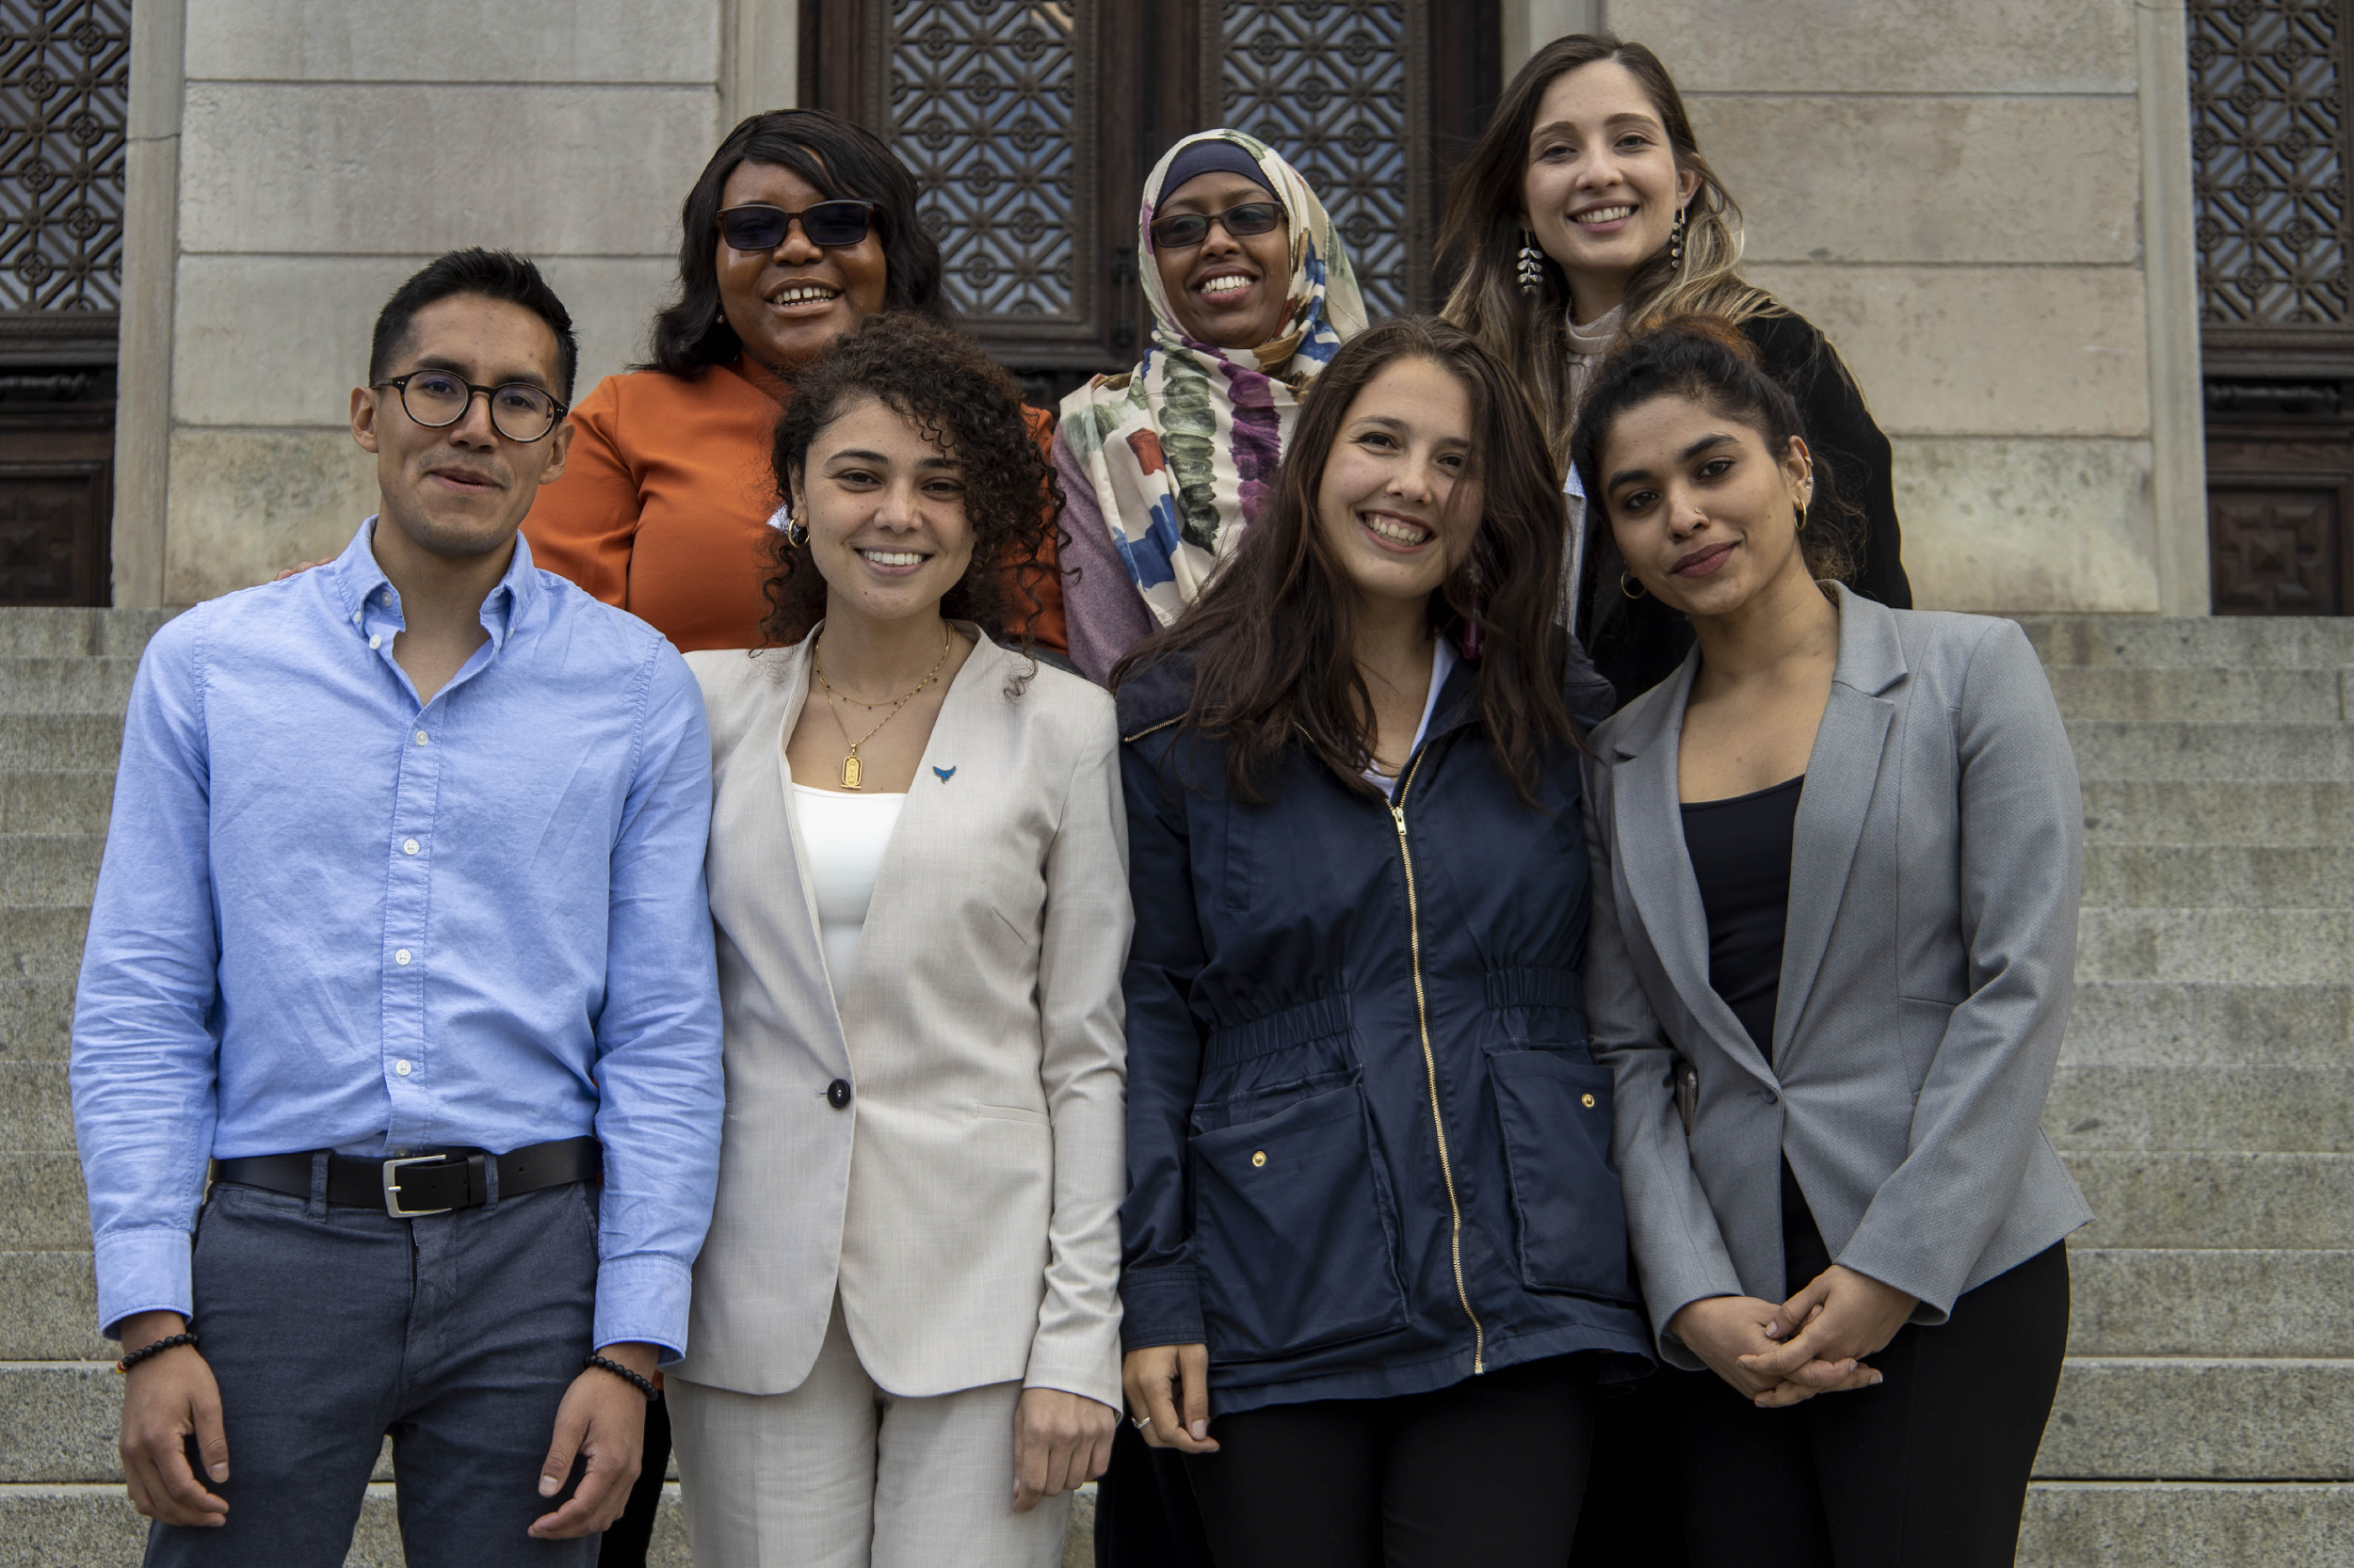
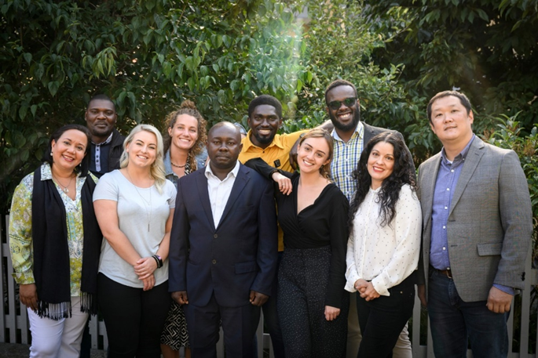
Uppsala Rotary Peace Center

Slide 12
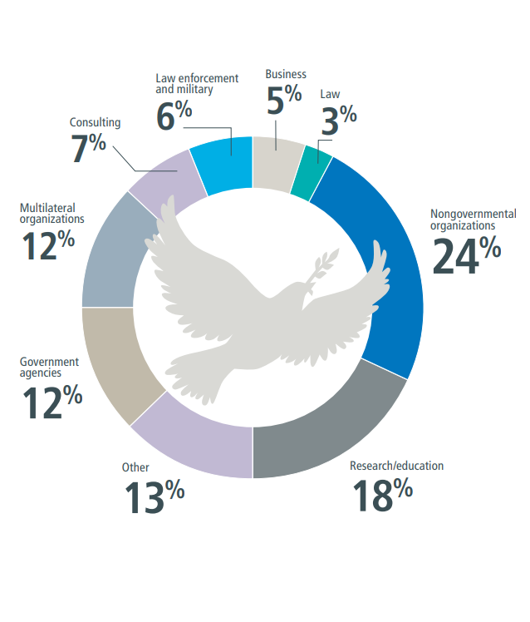
Program alumni serve as leaders in government and nongovernment agencies, education and research, multilateral organizations such as United Nations agencies and the World Bank, law enforcement and the military, law, media and the arts, and other peacebuilding organizations.
Notes:
93% of the more than 1,600 working alumni say they are in jobs connected to peace and development in more than 140 countries.
• 24% Nongovernmental organizations
• 18% Research/education
• 13% Other
• 12% Government agencies
• 12% Multilateral organizations
• 7% Consulting
• 6% Law enforcement and military
• 5% Business
• 3% Law

Slide 13
Rotary Peace Fellowship Alumni Association
The Rotary Peace Fellowship Alumni Association connects past peace fellows for networking and facilitates collaboration between them and Rotary clubs to promote peace around the globe.
The association’s speaker database connects Rotarians with alumni who are willing to speak at club meetings, for webinars, or during town hall meetings.
The group’s YouTube channel offers recordings of presentations by alumni.

Slide 14
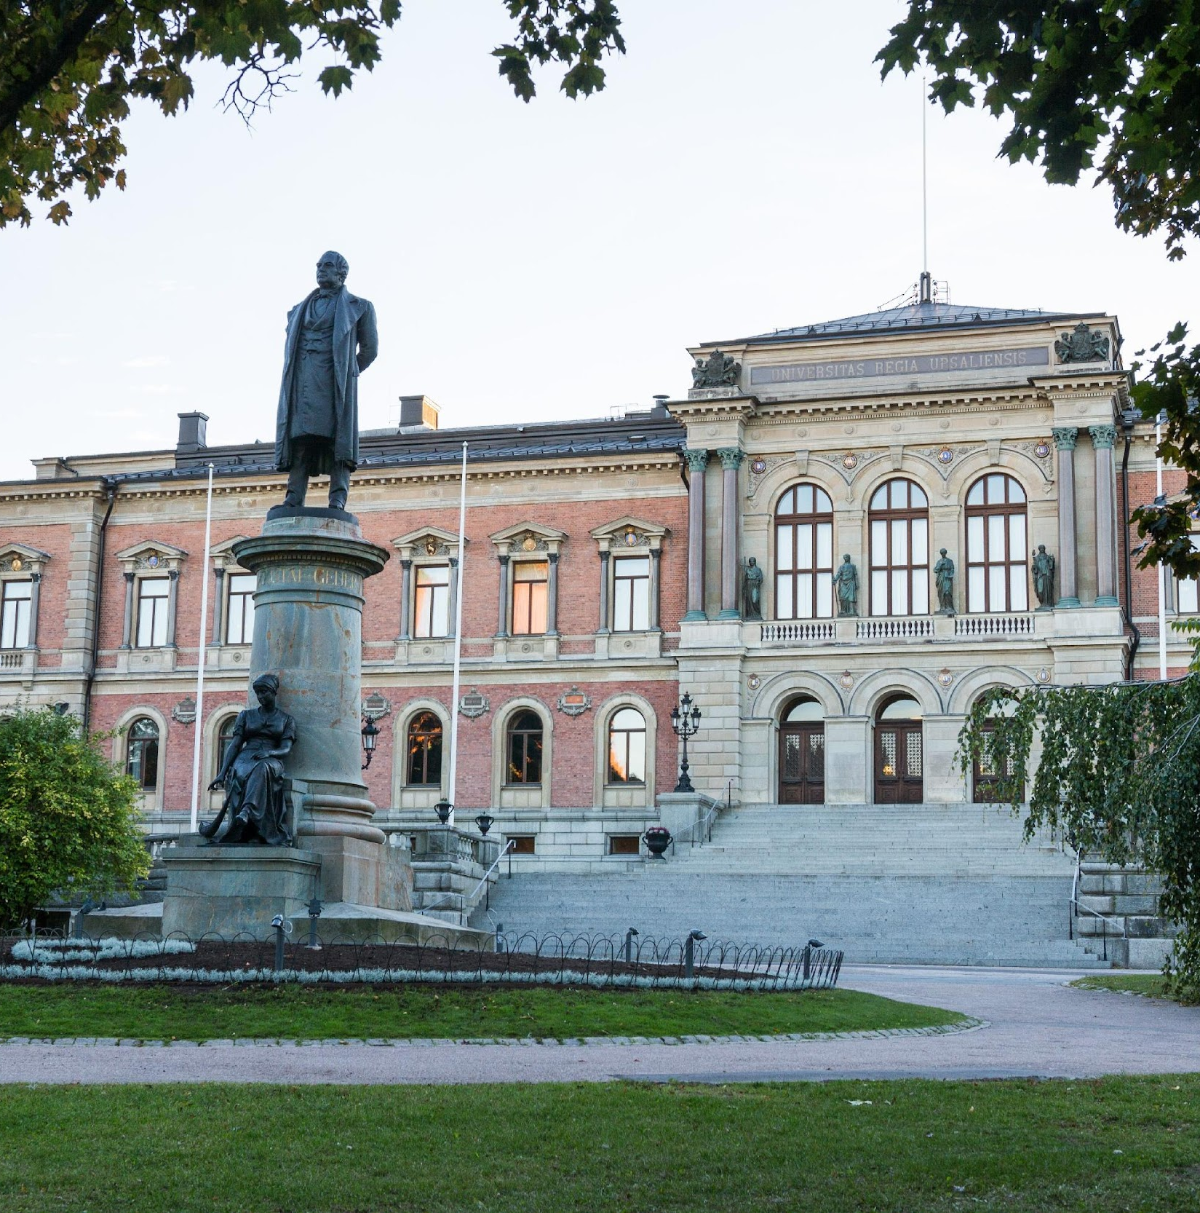
Uppsala
Engage with the Peace Fellowship
Attend the Annual Rotary Seminar in Uppsala on 21st April 2023, fellows will be presenting their thesis and experience.
Invite Uppsala fellows to make presentations to your club.
Sponsor Swedish applicants to study in the other 6 peace centers around the world.

Slide 15
Questions & Comments
For more information about the annual seminar in Uppsala , please contact the centre
Uppsala Rotary Peace Center
Email: rotarypeace@pcr.uu.se

